Slide 1





Human mobility analysis and simulation with Python
Luca Pappalardo
@lucpappalard
Roberto Pellungrini
@pellungrobe
Gianni Barlacchi*
@GianniBarlacchi
*work done while the author was at Fondazione Bruno Kessler
Applied Machine Learning Days, Lausanne. Switzerland
Notes:
Luca

Slide 2
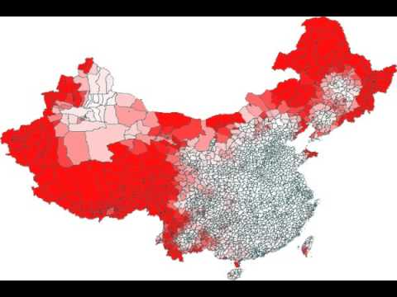
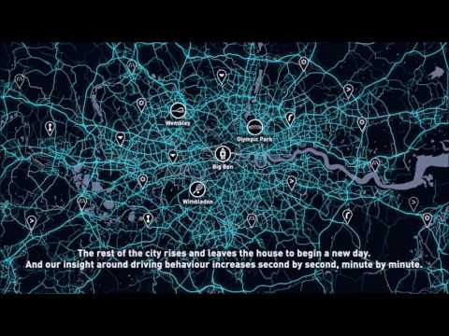
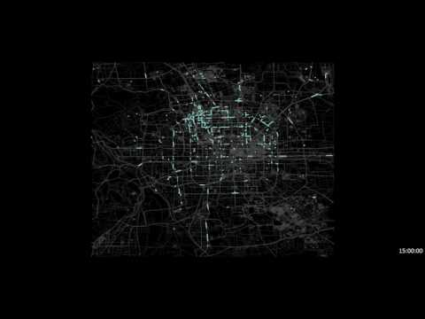
Notes:
Health
Infectious diseases spread because people move. In the past epidemics like the black plague were diffusing slowly from one town the nearest one, today new flu strains like H1N1 spread faster across the continents travelling on the air transport network
Transportation affects our health in other ways too: in the US the typical commute lasts more than 30 minutes: overall we spend 1 hour travelling
the stress associated with traffic jams has an impact on our wellbeing, while the pollutants released by combustion engines pose a threat to our health
Environment
These pollutants do not harm just humans, but other species and the environment as well. Transportation is the second source of greenhouse gas emissions to the atmosphere and is one of the main human activities contributing to global warming and climate change.
Economy
In the EU transportation the second largest expenditure category after housing (15-25%). More efficient forms of transportation and better urban planning could help us save money and reduce the damage we do to the environment.

Slide 3

Human mobility is the study that describes how humans move within a network or system.

Slide 4
What you will learn today
Dealing with mobility data loading, cleaning and preprocessing
Measuring mobility quantities distances, predictability, mobility habits

Slide 5
Two Applications
Car Crash prediction how to exploit human mobility analysis to forecast whether a vehicle will crash
Migration Flow prediction how to predict the flows of people between locations on a city/region/country
Notes:
https://www.nature.com/articles/s41586-018-0095-1

Slide 6
Representing mobility data

Slide 7
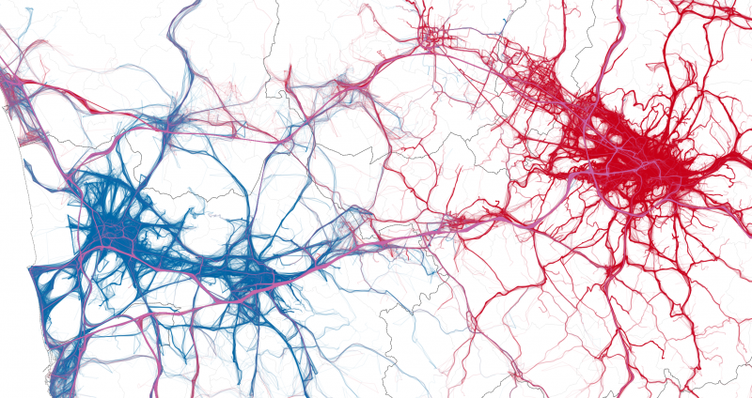

Slide 8
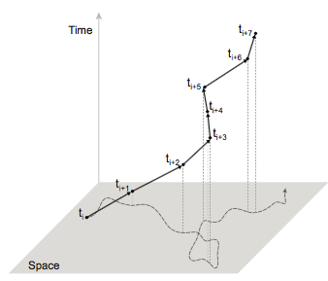

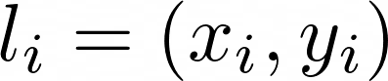
Trajectory. The trajectory of an object u is a temporally ordered sequence of tuples
where is a location, x_{i} and y_{i} are the coordinates of the location, and t_{i} is the corresponding timestamp, with t_{i}< t_{j} if i < j.
Notes:
questa è l’informazione completa, a volte non riusciamo a seguire completamente la traiettoria dell’utente

Slide 9
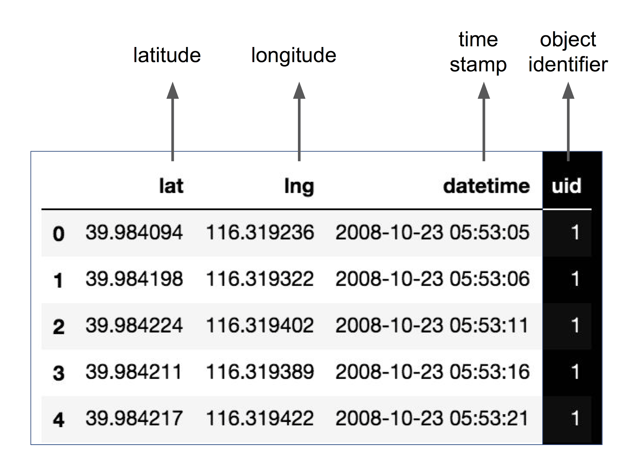
Notes:
questa è l’informazione completa, a volte non riusciamo a seguire completamente la traiettoria dell’utente

Slide 10
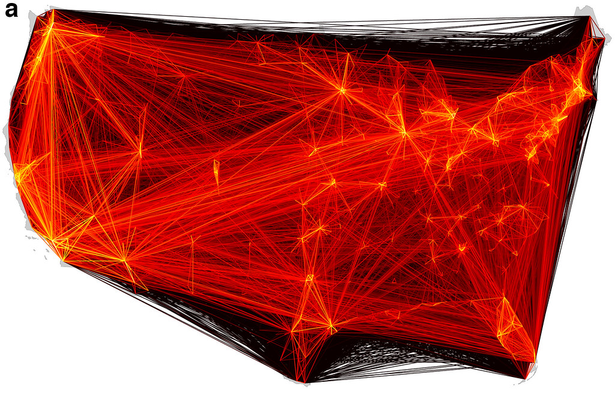
Notes:
questa è l’informazione completa, a volte non riusciamo a seguire completamente la traiettoria dell’utente

Slide 11
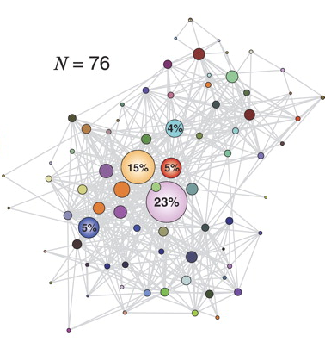
Flows. An Origin-Destination matrix T is a n×m matrix where:
n is the number of distinct “origin” locations
m is the number of distinct “destination” locations
T_{ij} is the number of objects traveling from i to j.
Notes:
questa è l’informazione completa, a volte non riusciamo a seguire completamente la traiettoria dell’utente

Slide 12
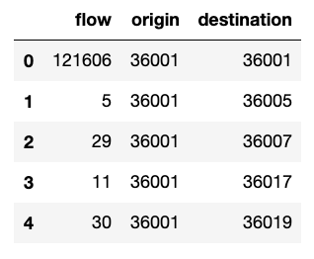
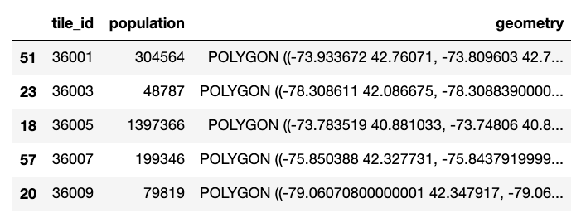
Notes:
questa è l’informazione completa, a volte non riusciamo a seguire completamente la traiettoria dell’utente

